Slide 1
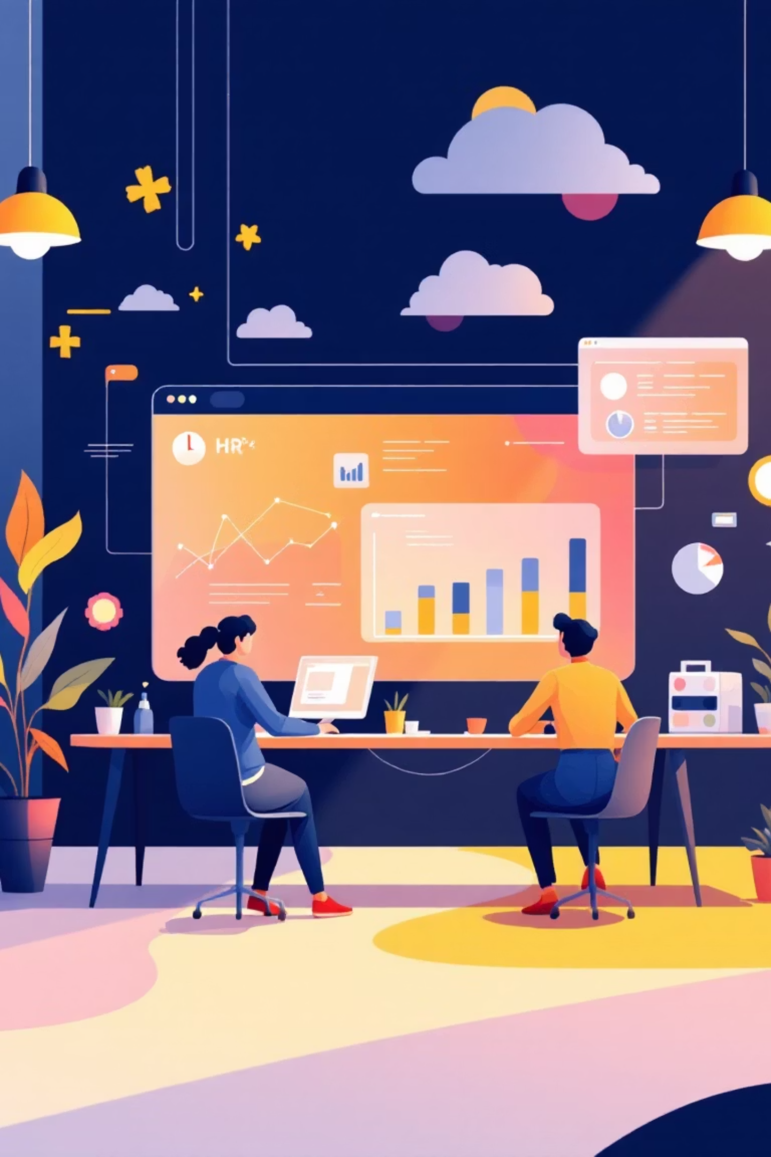
T-IQ: AI-Powered Talent Intelligence & Workforce Optimization Suite
Domain: Human Resource
Transforming human resource management through intelligent automation and data-driven insights in the age of digital workforce optimization.
https://tiq-hr-analytics.streamlit.app/
https://github.com/SanthiyaBaskar/TIQ-HR-Analytics
By : Santhiya Baskar

Slide 2

The HR Challenge
Today's HR teams face mounting pressures that drain productivity and increase costs. Traditional manual processes can no longer keep pace with modern workforce demands.
High Attrition
Slow Hiring
Unexpected employee turnover disrupts teams and increases recruitment costs
Manual resume screening creates bottlenecks in talent acquisition pipelines
Manual Screening
Skill Mismatch
HR teams spend countless hours reviewing applications instead of strategic work
Poor job-role alignment leads to dissatisfaction and early departures
T-IQ solves these critical challenges through automated, AI-powered intelligence that transforms HR
operations from reactive to proactive.

Slide 3
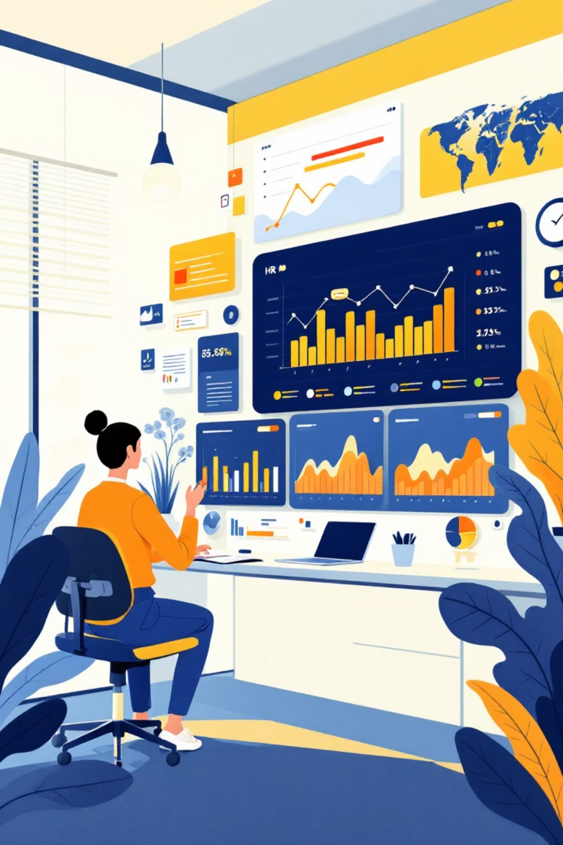
Comprehensive Workforce Intelligence Platform
System Goals
End-to-End Implementation
Automate resume screening with intelligent job-role matching algorithms
Advanced data engineering pipelines
Machine learning & deep learning models
Predict attrition risks before they impact business operations
Natural language processing systems
Transformer-based embeddings
Analyze employee sentiment from reviews and feedback channels
LLM-powered chatbot & summarization
Build visual dashboards for real-time workforce intelligence
Measurable Business Impact
25-40%
30-50%
70-80%
Faster Hiring
Better Matching
Less Manual Work
Reduced time-to-hire through automated screening
Improved job-role fit with
NLP models
Reduction in resume
screening time
40-60%
Lower Email Load
HR chatbot handles routine inquiries

Slide 4
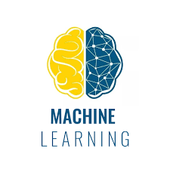
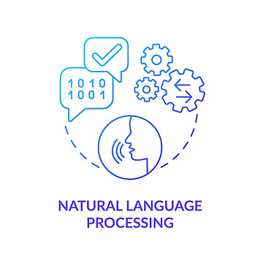
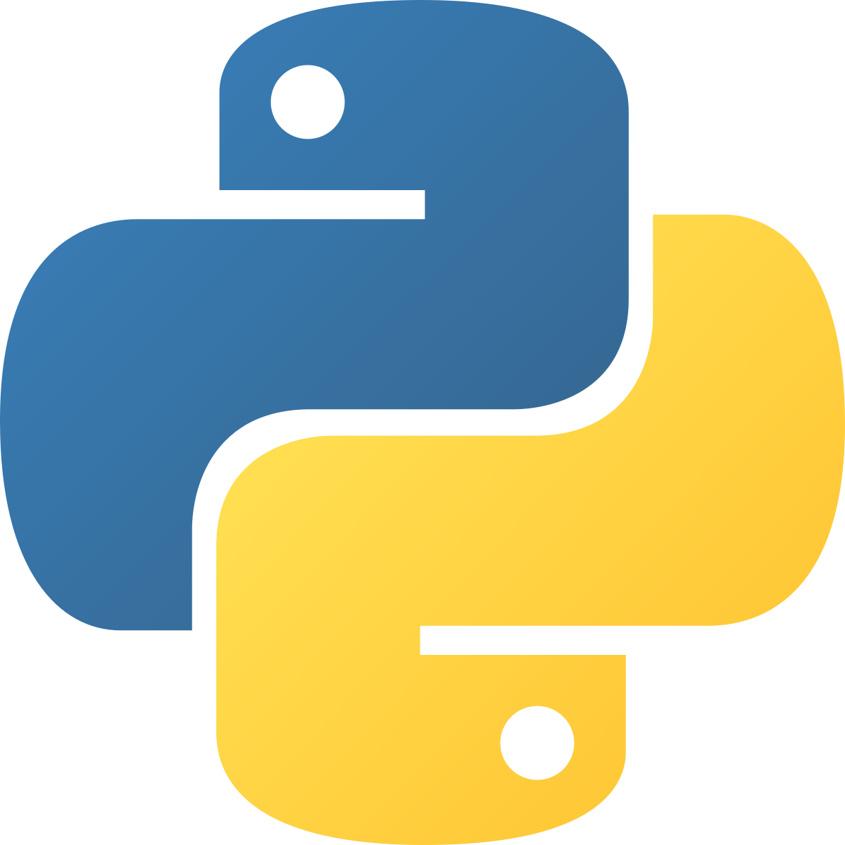
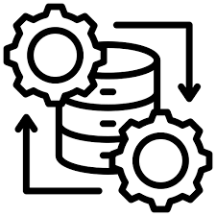
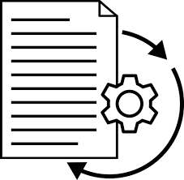
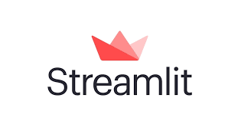
Technology Stack
T-IQ leverages cutting-edge technologies to deliver enterprise-grade HR intelligence with reliability and performance.
Programming
Python 3.11 – Core development language for all system components
ML & NLP
Scikit-Learn for TF-IDF & cosine similarity
Regex-based resume parsing
VADER sentiment scoring
Data Processing
Pandas for data cleaning & merging
NumPy for numerical operations
UI & Visualization
Streamlit for interactive dashboards
Plotly for dynamic charts
Document Processing
pdfplumber for PDF extraction
python-docx for Word documents

Slide 5
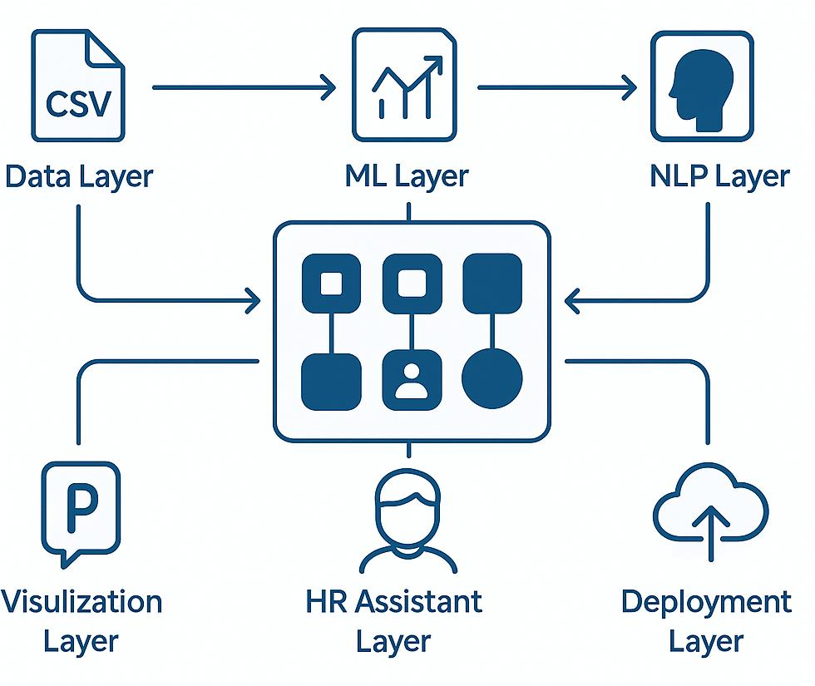
Intelligent System Architecture
Data Layer
CSV datasets undergo rigorous cleaning, formatting, merging,
and missing value handling to ensure data quality
ML Layer
Attrition scoring models combined with TF-IDF and token similarity
algorithms for intelligent resume and job matching
NLP Layer
Advanced resume parsing extracts skills, contact info,
and experience while sentiment classification analyzes employee feedback
Visualization Layer
Streamlit dashboards with interactive Plotly charts
present insights in clear, actionable formats
HR Assistant Layer
Rule-based Q&A system provides instant answers
to common HR queries and employee questions
Deployment Layer
Streamlit web application enables easy access and
seamless user experience across the organization

Slide 6
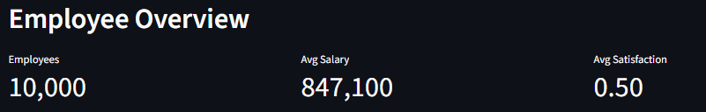
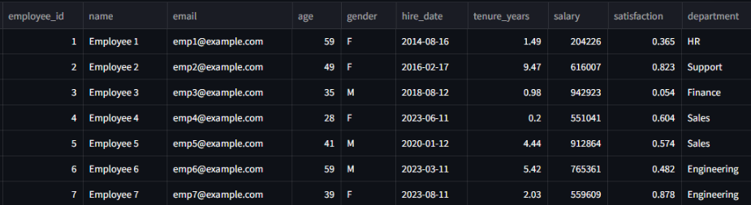
Comprehensive
Data Ecosystem
T-IQ processes diverse data sources to build a complete picture of workforce dynamics and talent intelligence.
Employee Data
Attrition Data
Resume Files
Synthetic employee records including age, role, salary, tenure, and satisfaction metrics
Employee attrition labels with calculated risk values for predictive modeling
Text and PDF resumes used for automated skill extraction and candidate profiling
Job Descriptions
Review Data
Sentiment Labels
Detailed job titles, required skills, and comprehensive role descriptions
Employee review text with ratings for sentiment analysis and engagement tracking
Reviews tagged as positive or negative for training classification models
Skills Database
Extracted skills from resumes and job descriptions for matching algorithms

Slide 7
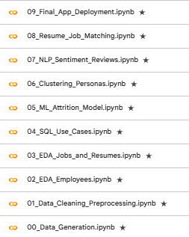
End-to-End Development Journey
Ten comprehensive Juapyter notebooks document the complete system development
from data generation through production deployment.
01
02
Data Generation
Data Cleaning &
Preprocessing
Creating synthetic datasets for testing and development
Preparing raw data for
analysis and modeling
03
04
Employee EDA
Jobs & Resumes EDA
Exploratory analysis of workforce patterns and trends
Understanding talent
pool and position requirements
05
06
SQL Use Cases
ML Attrition Model
Database queries for business intelligence
Building predictive models
for employee retention
07
08
Clustering Personas
NLP Sentiment Reviews
Identifying employee segments and patterns
Analyzing employee
feedback and satisfaction
09
10
Resume-Job Matching
Final App Deployment
Intelligent candidate-position alignment system
Production-ready
Streamlit application

Slide 8
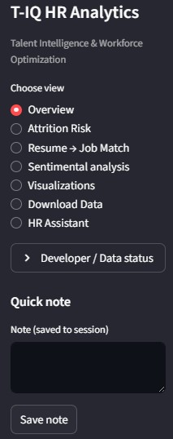
Streamlit Application Interface
The T-IQ Streamlit application delivers comprehensive HR intelligence through an intuitive, powerful interface designed for daily use.
Workforce Overview
EDA Insights
Visual distribution of salary, tenure, and satisfaction metrics across the organization
Department-level analysis
Salary spread visualization
Tenure distribution patterns
Attrition Risk Engine
Correlation heatmaps
Identifies high-risk employees with visual score charts and actionable insights
HR Chatbot
Instant AI-powered answers for common HR queries, policies, and employee questions
Resume-Job Matching
Matches candidate profiles with open positions, showing top 3 best-fit roles with detailed explanations
Sentiment Analysis
Real-time sentiment scoring of employee reviews with positive vs negative distribution

Slide 9
Future Vision & Real-World Applications
Planned Enhancements
Enterprise Applications
Enhanced Accuracy
Improved models for matching, sentiment analysis, and attrition prediction
Recruitment
Real-Time Tracking
Automated screening and fast job-role matching
Live sentiment monitoring with mobile-accessible HR dashboards
Document Verification
Engagement
Monitor sentiment to understand workplace mood
Key Learnings
Attrition Management
CNN-based detection of fake or tampered documents
Identify high-risk employees for early intervention
Built a complete HR Intelligence Suite end-to-end
Successfully combined ML, NLP, EDA, and dashboards
Automated major time-consuming HR tasks
Workforce Planning
Gained real-world data engineering and deployment experience
Dashboards for staffing, salary, and tenure insights
Created a scalable, enterprise-ready system
Challenges Overcome
Handling missing and incomplete data effectively
Designing a clean, intuitive user interface
Ensuring fast performance in Streamlit environment

Slide 10
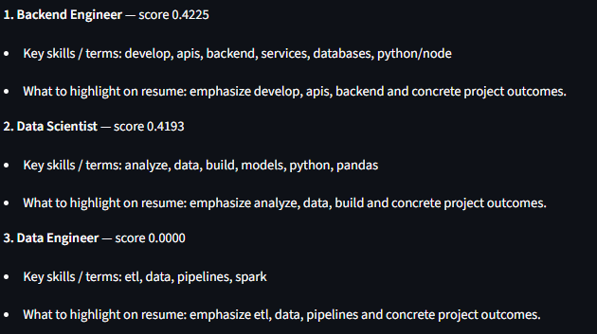





Results & Performance
Model Accuracy & Performance
85-90%
88-95%
90%
Attrition Prediction
Resume-Job Match
Sentiment Analysis
Risk assessment
accuracy
Candidate-role
alignment
Review classification
accuracy
System Capabilities
Deployment Success
Automated resume parsing and skill extraction
Runs smoothly on Streamlit platform
Top 3 job-role recommendations with explanations
Lightweight and resource-efficient
High-risk employee identification and alerts
Easy to use with minimal training
Visual workforce insights and analytics
Instant analysis output and results
Fully interactive Streamlit HR dashboard
Production-ready for enterprise deployment
T-IQ represents the future of HR technology – where artificial intelligence transforms talent management into a strategic advantage, empowering
HR teams to focus on what matters most: people.

